Slide 1
Corinne davis-cooke
cOMMUNIty Engagement Ranger

Slide 2
What do we do?
Ensure that the 3000 miles of rights of way (RoW) across Hampshire are well maintained and fit for purpose.
Liaise with parish councils and landowners on improvement projects and assist with funding.
Co-ordinate an “army” of volunteers who provide the eyes and ears on the RoW network assisting the ranger team with tasks and fulfilling inspection duties.
Act as the “public face” for the Access Team - attending meetings, updating social media and promoting correct use of rights of way.

Slide 3
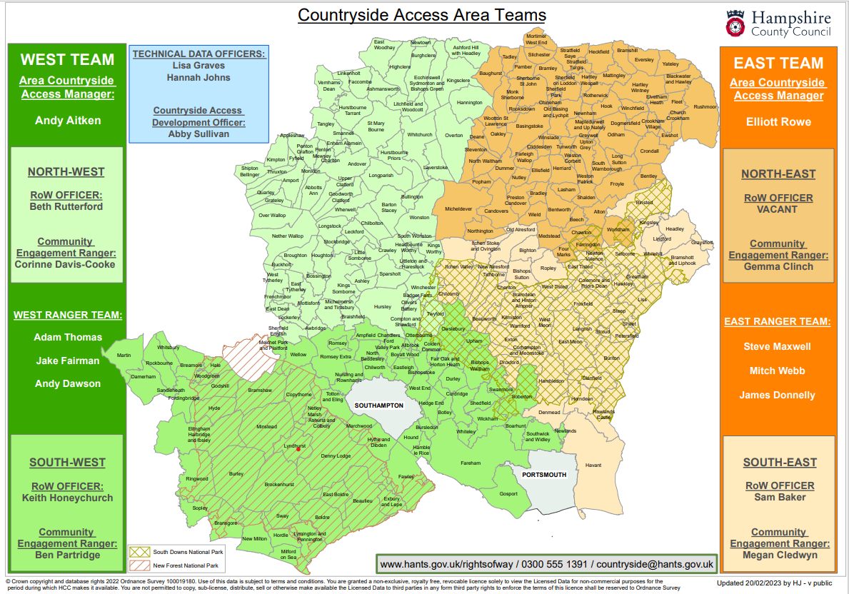

Slide 4
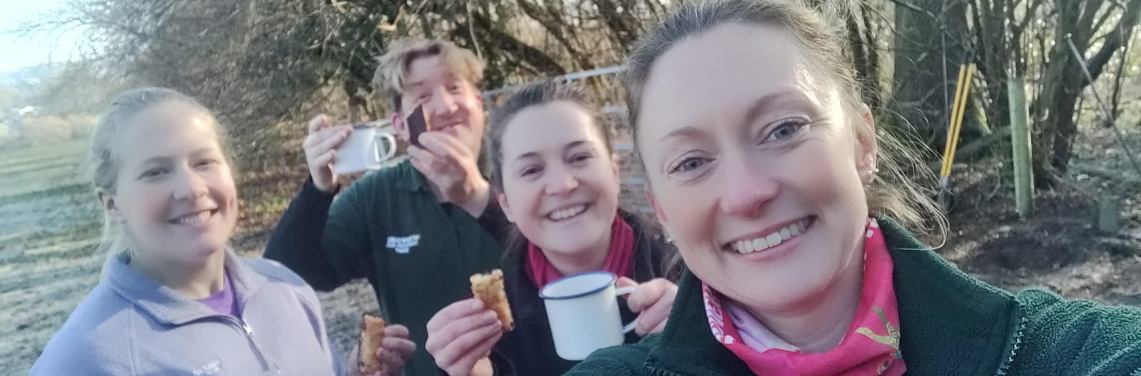
We’re a friendly bunch!

Slide 5
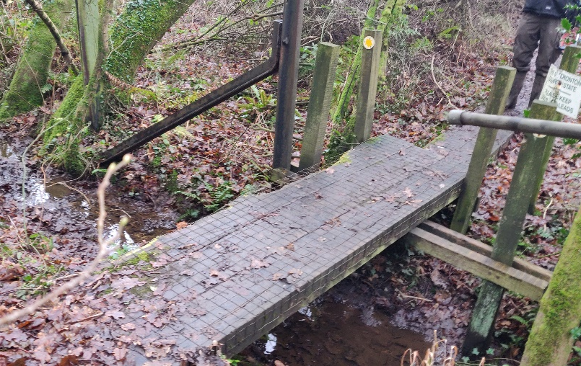
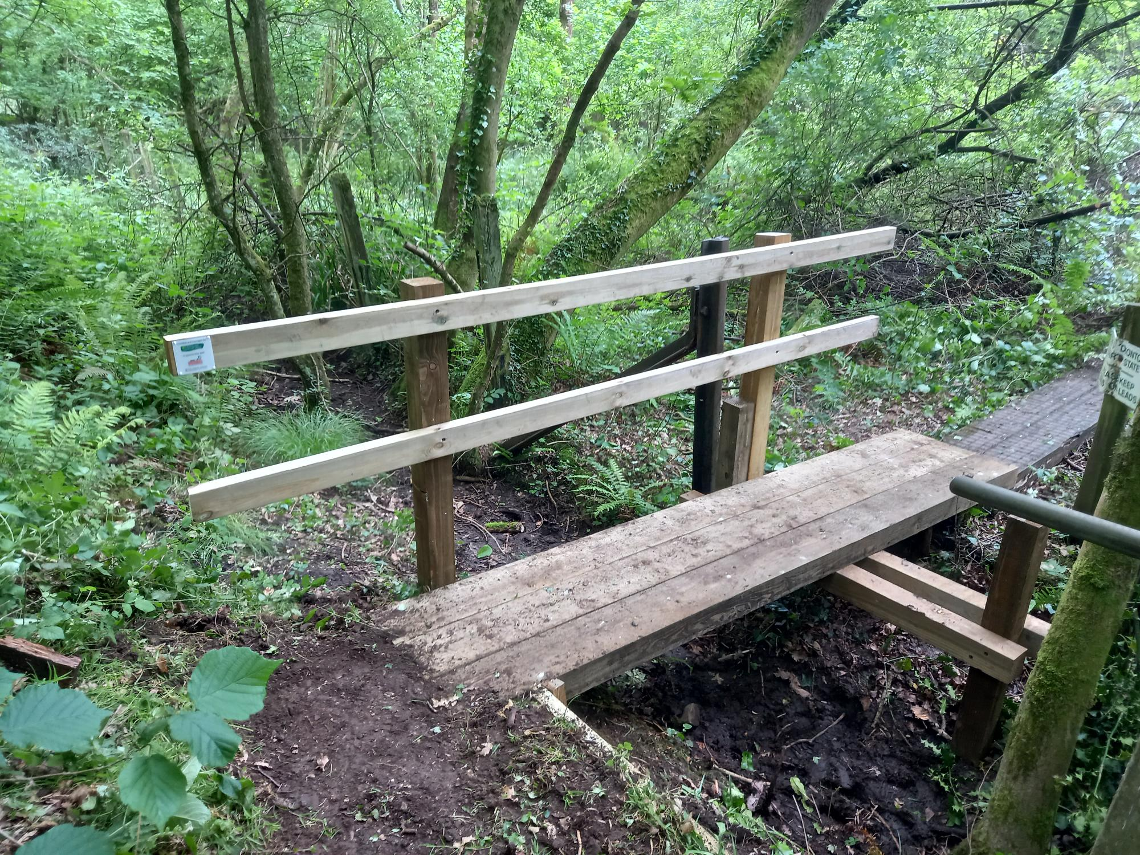
Previous Projects

Slide 6
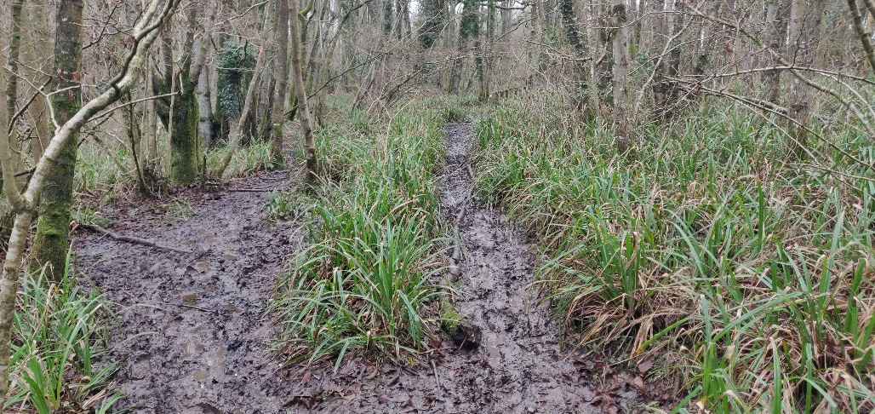
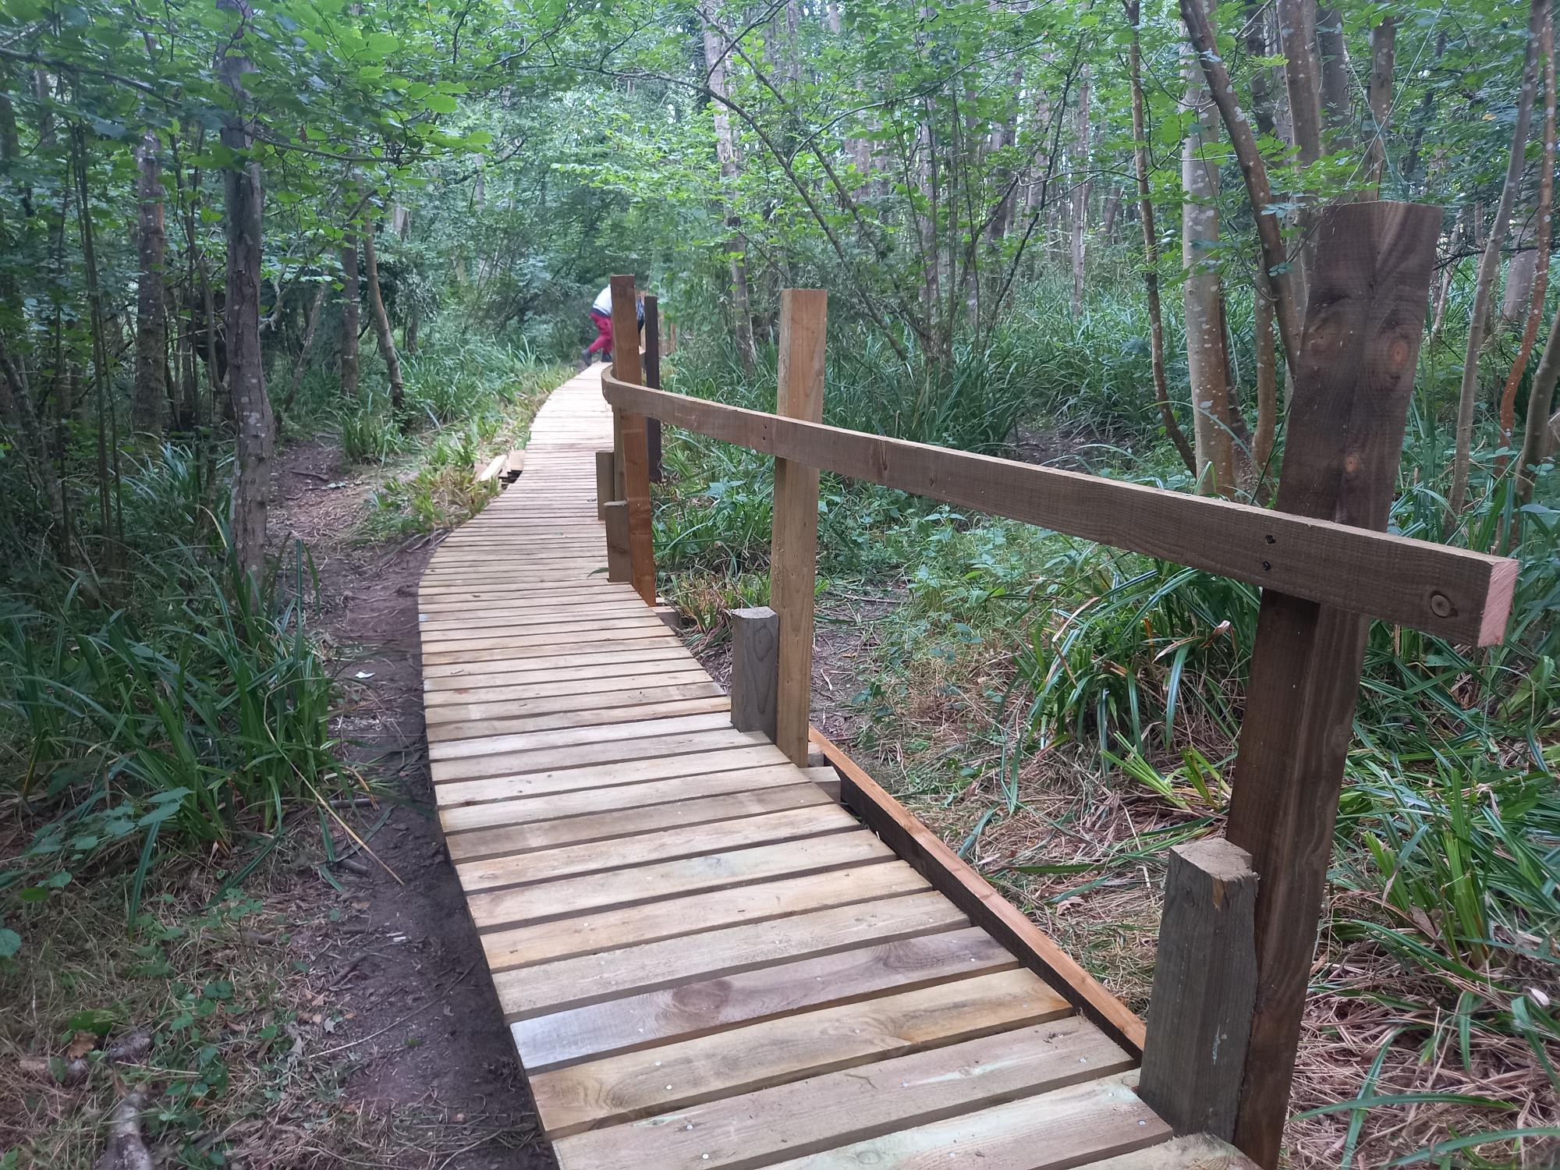
Previous Projects

Slide 7
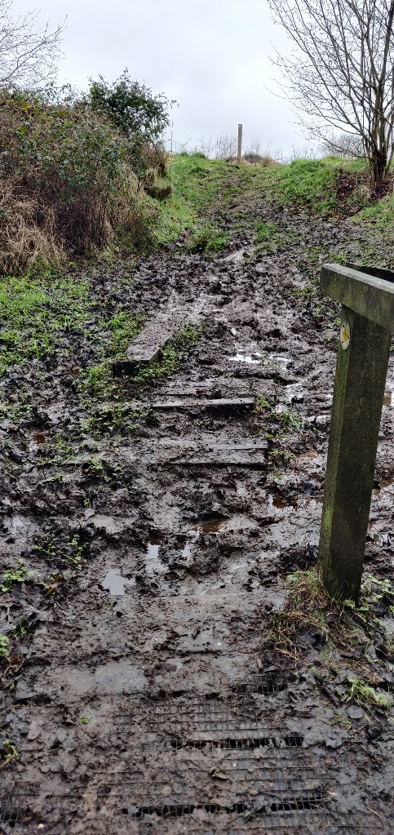
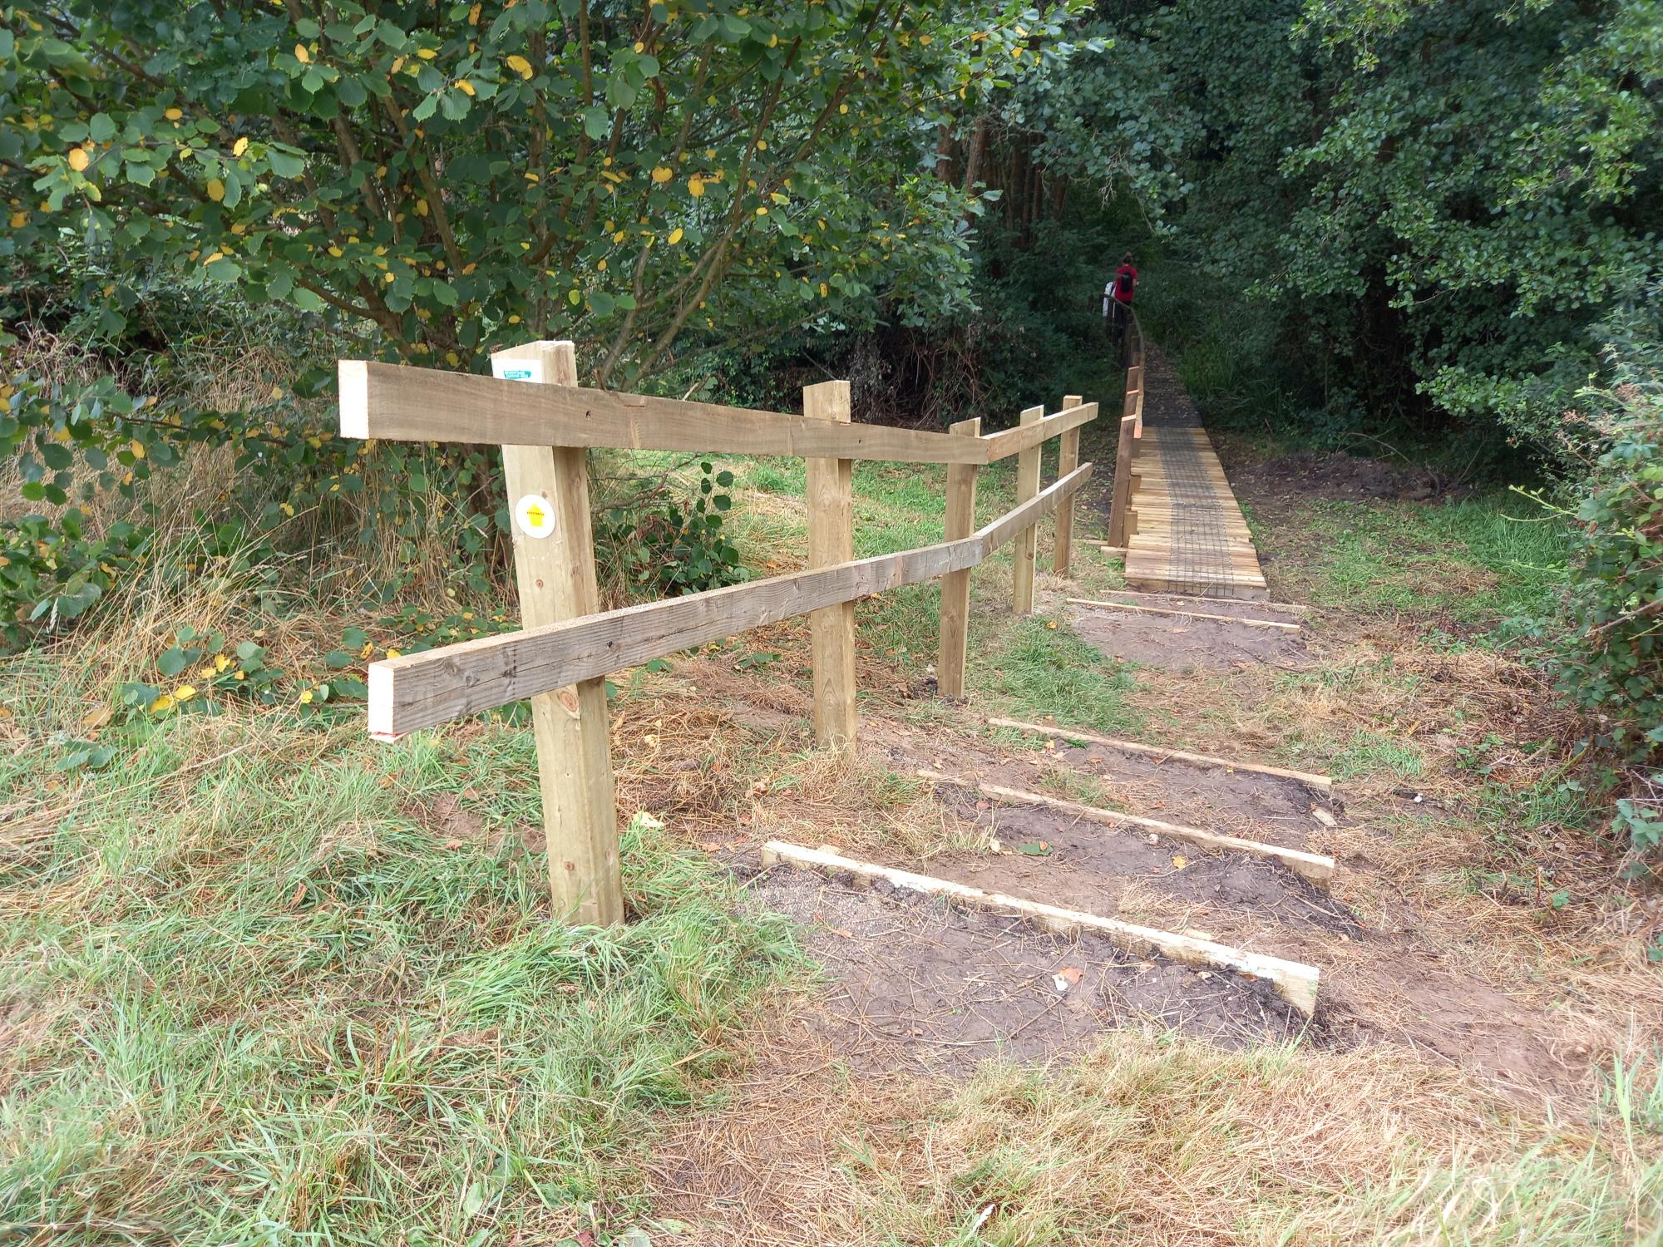
Previous Projects

Slide 8
How can you help?
Reporting issues
Any member of the public can report an issue on a RoW.
This is then assigned to the appropriate person to solve – some problems are landowner responsibility, some are HCC
Some issues solved with volunteer task days (eg vegetation cuts and installing furniture)

Slide 9
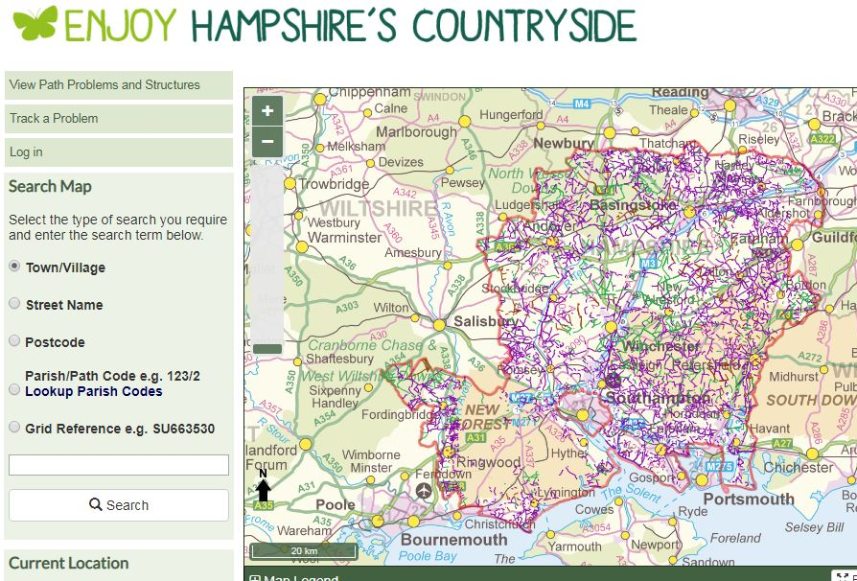

Slide 10
How can you help?
Path warden tasks
Assigned by CERs to investigate issues on RoW
Attend a training day to learn more about RoW responsibilities and to receive tool bag
Can carry out waymarking duties

Slide 11
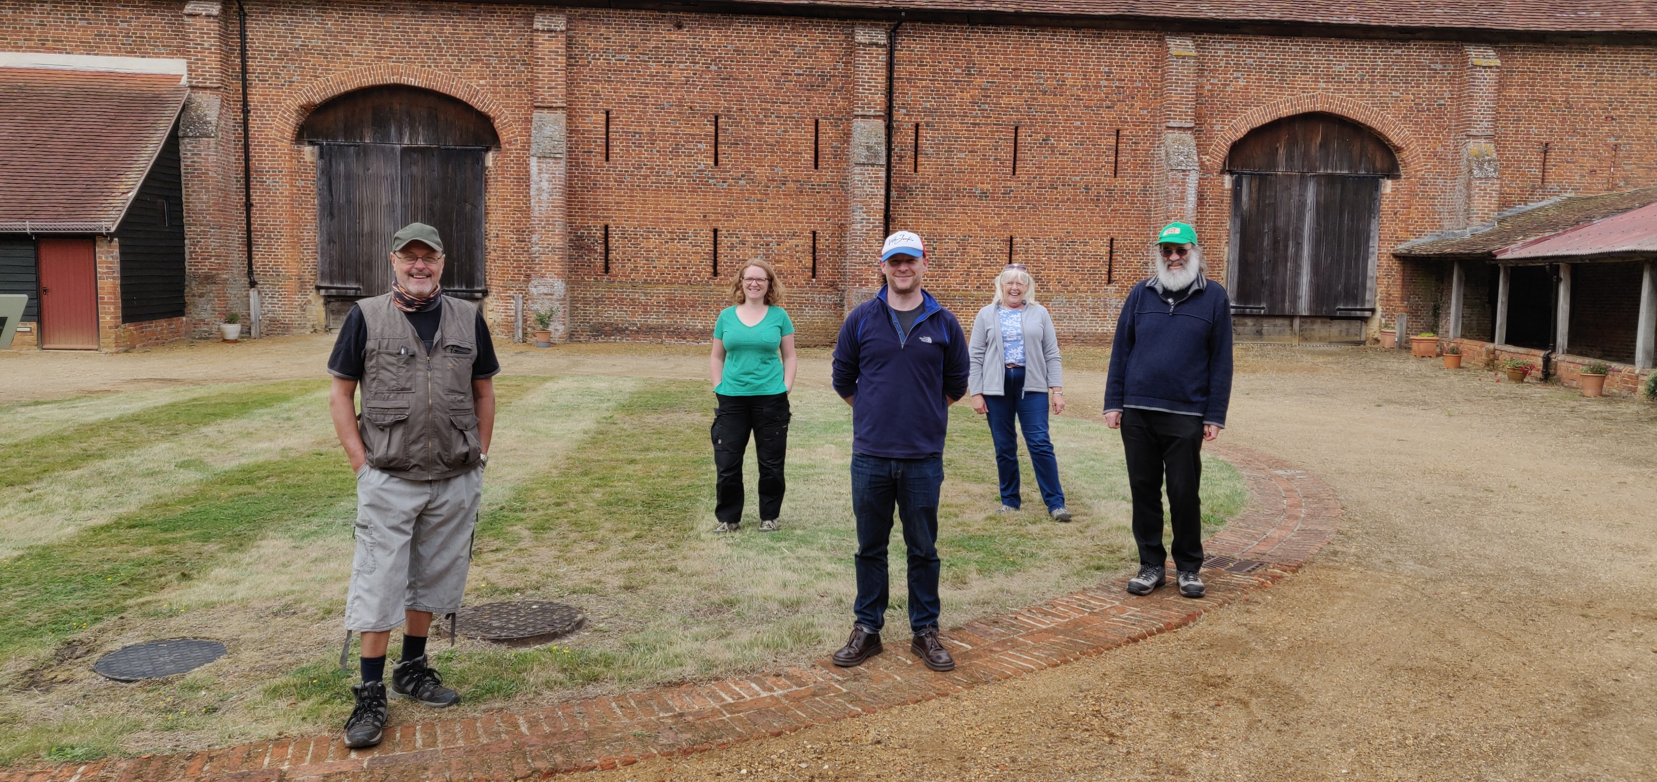

Slide 12
Why volunteer?
Social event
Give back to the community
Physical & Mental Wellbeing
Learn new skills
Fun!

Slide 13
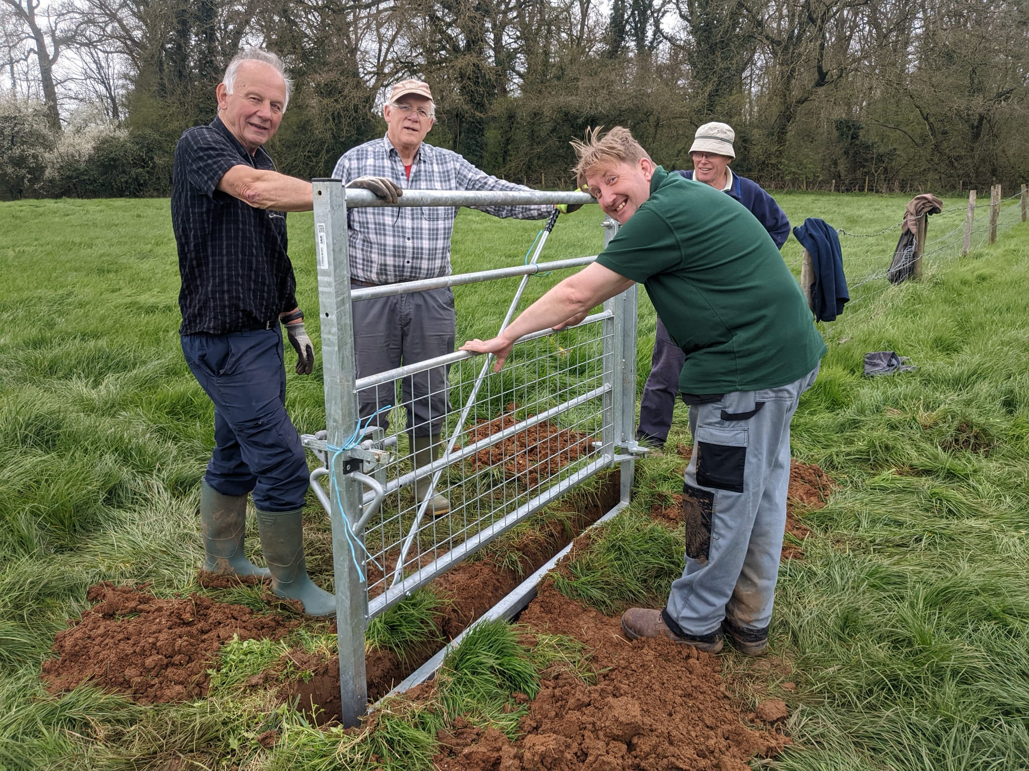
Task Days

Slide 14
Countryside Access Parish Delivery Partnership
Funding for RoW improvements
Open now for 2023! Limited funding on first come first serve basis
Aimed at parish council, landowners or walking groups

Slide 15
What next?
General enquiries: prow@hants.gov.uk
To reach me directly: corinne.davis-cooke@hants.gov.uk
Or search “Rights of Way Hampshire” to reach the Council webpages
Find us on Facebook & Instagram
Get Involved! No experience needed, just enthusiasm

